Slide 1

Software Development Methodologies
SHALOMSHAN
CSD BATCH:-08
SCHOOL OF COMPUTTING

Slide 2

Agenda
Stage of SDLC
Analysis
Planning
Implementation
Testing
SDLC Model
Build & Fix Model
Water Fall Model
Interactive Enhancement Model
Prototyping Model
Spiral Model
RAD Model
Disadvantage of RAD Model
Thankyou

Slide 3
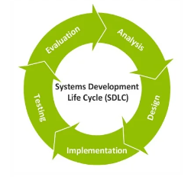
Stage of SDLC
Analysis
Planning
Implementation
Testing

Slide 4

Analysis
The first and the most important phase in the SDLC.
Determine where the problem is.
Breaking down the system requirements.
Must be done carefully.
Any error in this phase will cost a lot !!

Slide 5

Planning
Determine who will do what !
Tasks are assigned to team members.
It all starts here.

Slide 6

Implementation
The most expensive phase.
Also the longest one!

Slide 7

Testing
The never-ending phase.
In this phase we TEST, TEST, TEST, and TEST.
Very important phase.

Slide 8

SDLC Model
Build and fix model
Water Fall model
Iterative enhancement model
Prototyping model Spiral Model

Slide 9

Build & Fix Model
Product is constructed without specifications or any attempt at design
Adhoc approach and not well defined
Simple two phase model
Suitable for small programming
Maintenance is practically not possible
Code soon becomes unfixable & un enhance able

Slide 10
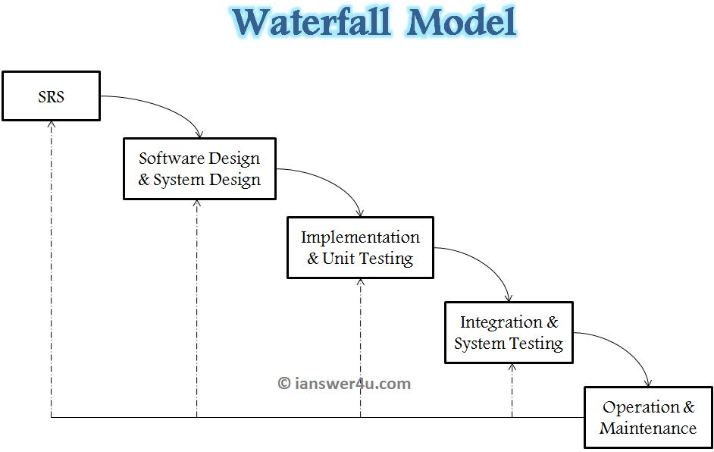
Water Fall Model
Water Fall Model The waterfall model is the oldest and most widely used model in the field of software development. This model is named “waterfall model” because its diagrammatic representation resembles a cascade of waterfalls. This model is easy to understand and reinforces the notion of “define before design” and design before code. The model expects complete & accurate requirements early in the process, which is unrealistic

Slide 11
Iterative Enhancement Model
This model has the same phases as the waterfall model, but with fewer restrictions. Generally the phases occur in the same order as in the waterfall model, but they may be conducted in several cycles. Useable product is released at the end of the each cycle, with each release providing additional functionality.
Customers and developers specify as many requirements as possible and prepare a SRS document.
Developers and customers then prioritize these requirements
Developers implement the specified requirements in one or more cycles of design, implementation and test based on the defined priorities.

Slide 12

Prototyping Model
The prototype may be a usable program but is not suitable as the final software product.
The development of a prototype might involve extra cost.

Slide 13
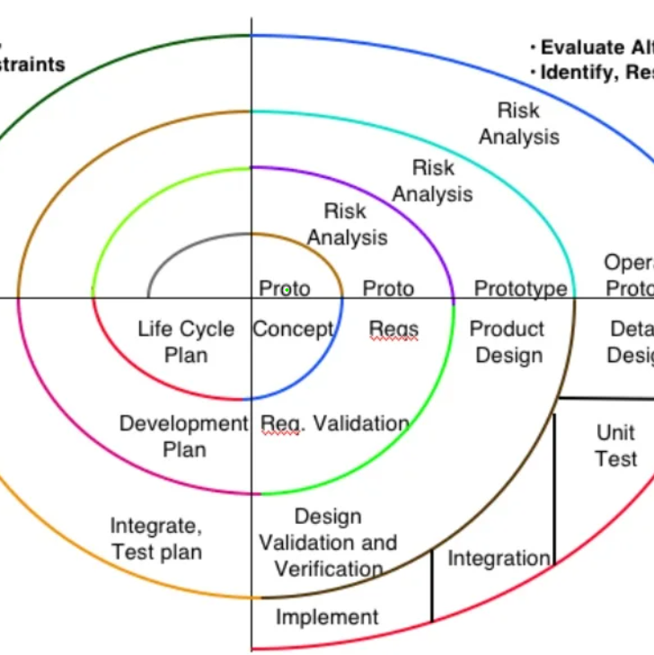
Spiral Model
The radial dimension of the model represents the cumulative costs. Each path around the spiral is indicative of increased costs. The angular dimension represents the progress made in completing each cycle. Each loop of the spiral from X-axis clockwise through 360o represents one phase. One phase is split roughly into four sectors of major activities.
Planning: Determination of objectives, alternatives & constraints
Risk Analysis: Analyze alternatives and attempts to identify and resolve the risks involved.
Development: Product development and testing product.
Assessment: Customer evaluation

Slide 14
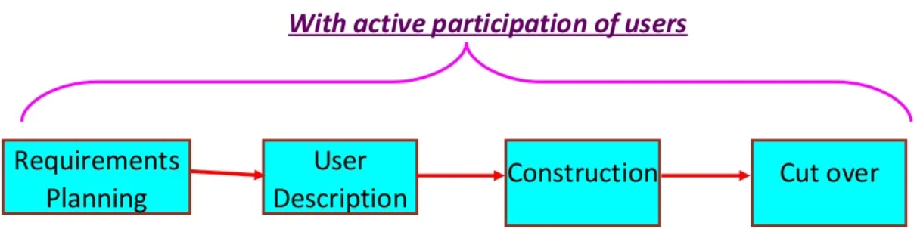
RAD Model
Developed by IBM in 1980
User participation is essential
Build a rapid prototype
Show it to user
Prototype is refined

Slide 15

Disadvantage of RAD Model
Not an appropriate model in the absence of user participation.
Highly specialized & skilled developers are required & such developers are not easily available.

Slide 16

Thank You

